Slide 1
UNIT - 1
Getting started with Responsive Web Design

Slide 2
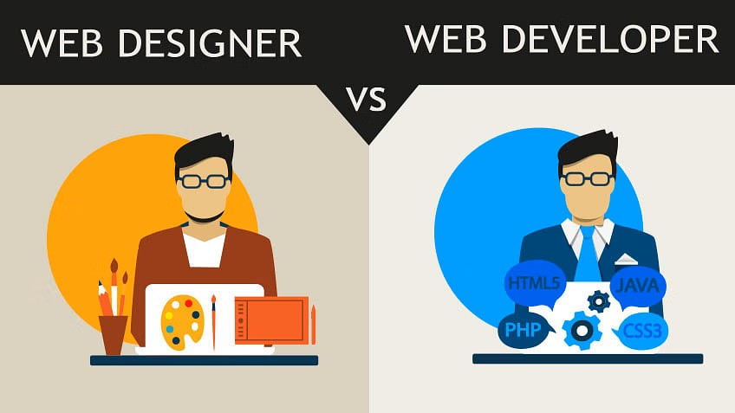

Slide 3
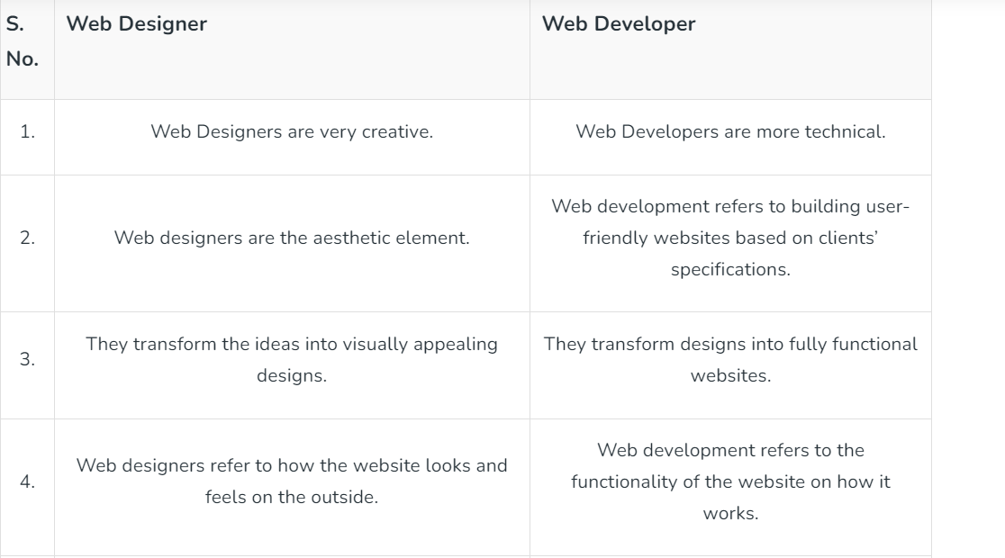

Slide 4
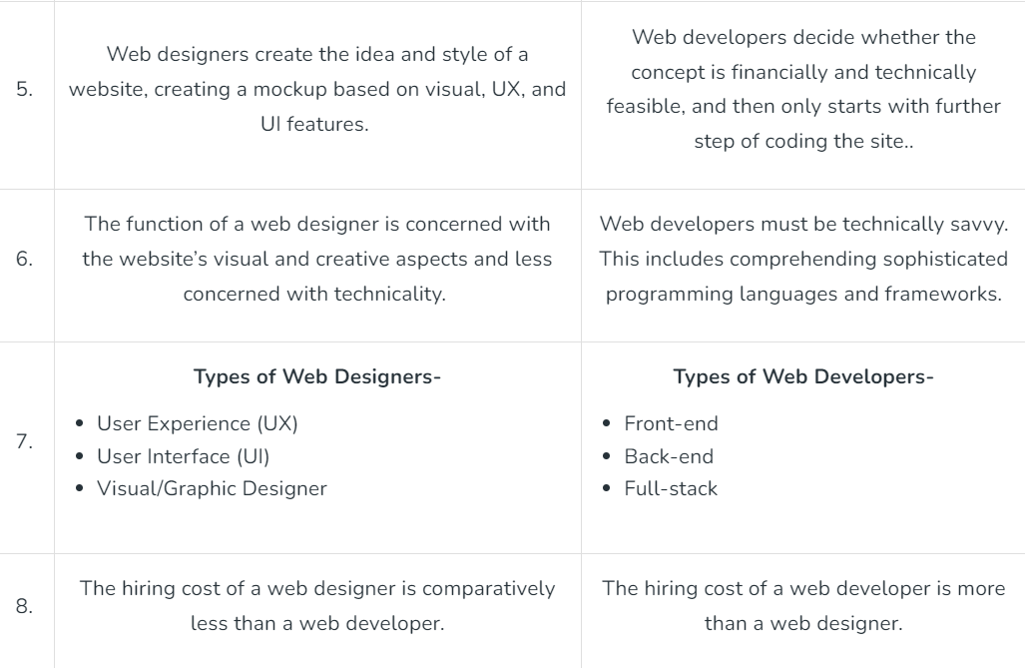

Slide 5
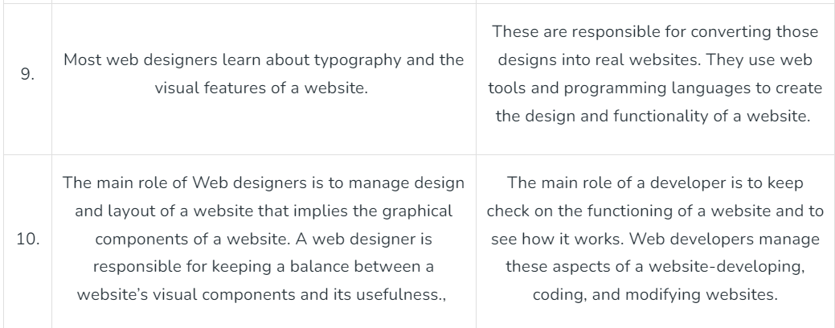

Slide 6
Web designing

Slide 7
Web design
Web design refers to the design of websites.
It usually refers to the user experience aspects of website development rather than software development.
Web design used to be focused on designing websites for desktop browsers; however, since the mid-2010s, design for mobile and tablet browsers has become ever-increasingly important.
Effective web design is not only visually appealing but also considers usability, accessibility, and the overall user experience to create a successful online presence

Slide 8
Key aspects of web designing include:
Graphic Design: Web designers use graphic design tools such as Adobe Photoshop or Illustrator to create the visual elements of a website, including images, logos, and other graphical components.
Layout Design: Designers work on the layout of a website, determining the arrangement of text, images, and other elements on each page. This includes considerations for navigation and user experience.
Color Scheme: Choosing an appropriate color scheme is crucial for creating a visually cohesive and appealing website. Colors can also convey a brand's identity and evoke specific emotions.
Typography: Selecting suitable fonts and font sizes contributes to the readability and overall aesthetics of a website. Consistent and well-chosen typography enhances the user experience.

Slide 9
Key aspects of web designing include:
User Interface (UI) Design: User Interface (UI) Design is about making it easy for users to do what they want on a website or app. It's all about creating simple and friendly ways for people to interact. This includes designing buttons, forms, menus, and other things on the screen so users can have a good experience. The goal is to make everything easy to find, understand, and use, so users enjoy using the interface..
Responsive Design: With the increasing variety of devices and screen sizes, web designers often implement responsive design techniques to ensure that the website looks and functions well across different platforms, including desktops, tablets, and smartphones.
Web Design Tools: Designers use a variety of tools such as Adobe XD, Sketch, Figma, or other web design software to create and refine their designs.

Slide 10
Role of Web Designer
Web designers use a variety of tools and technologies to create the overall look and feel of a website, ensuring that it is both visually appealing and user-friendly.
A web designer works on a website's appearance, layout, and, in some cases, content.
Appearance relates to the colors, typography, and images used.
Layout refers to how information is structured and categorized. A good web design is easy to use, aesthetically pleasing, and suits the user group and brand of the website.
A well-designed website is simple and communicates clearly to avoid confusing users. It wins and fosters the target audience's trust, removing as many potential points of user frustration as possible.

Slide 11
Try this
Create a visually appealing design for a flower-selling shop.
Requirments:
Use proper colour schemes.
Use proper typography.
A proper layout should be there.
Relevant images should be included.

Slide 12
Responsive Web design

Slide 13
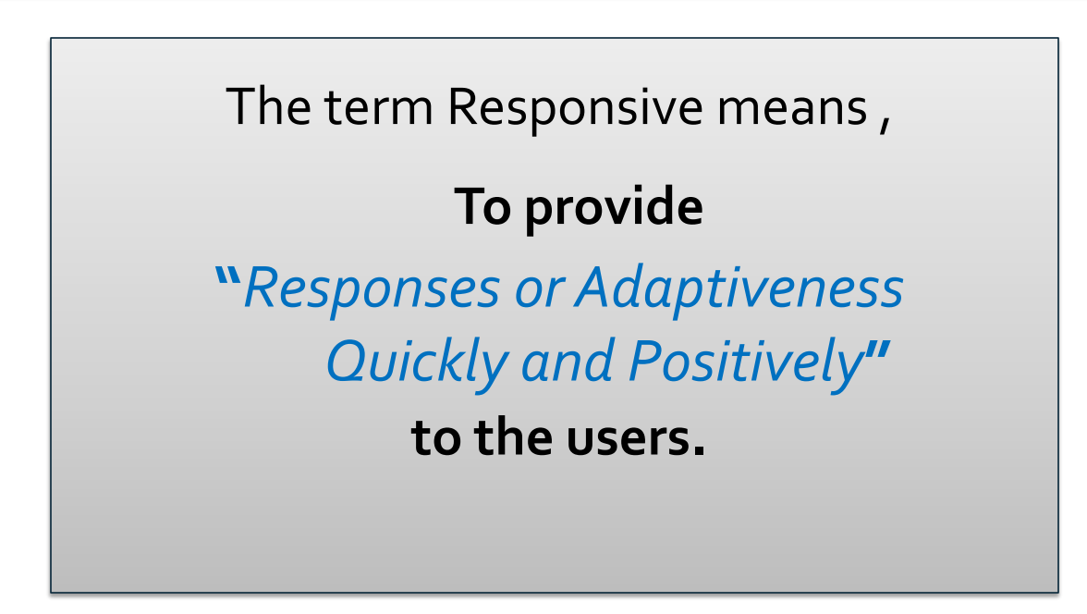

Slide 14
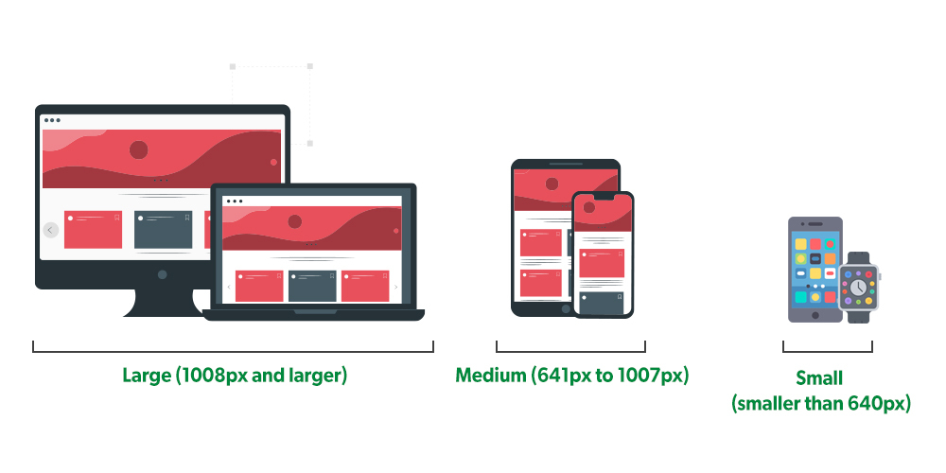

Slide 15
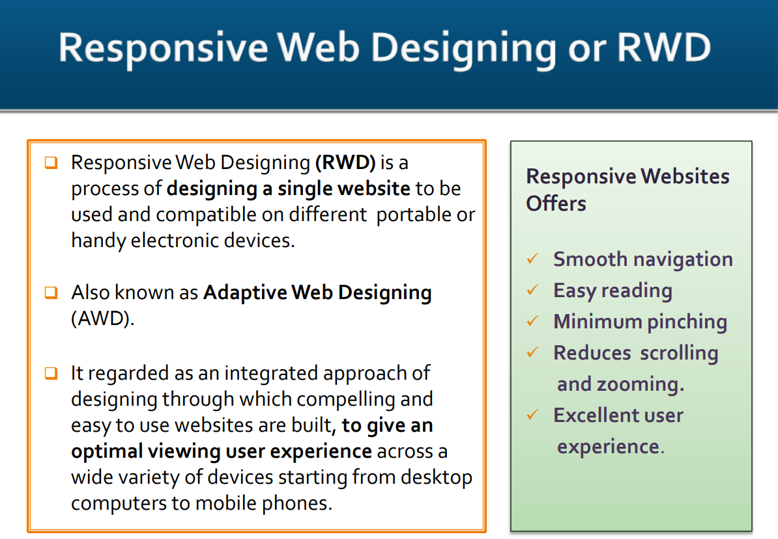

Slide 16
Introduction
A responsive website is one that has a fluid and flexible layout that enables it to adjust according to various screen sizes. Therefore, a responsive web design simply means a website design that responds and resizes itself depending on the device being used to view it whether it is a desktop monitor, laptop, smartphone, or tablet.
Responsive web design, also called RWD design, describes a modern web design approach that allows websites and pages to render (or display) on all devices and screen sizes by automatically adapting to the screen, whether it’s a desktop, laptop, tablet, smartphone, or even a smart TV!.
Responsive layouts automatically adjust and adapts to any device screen size, whether it is a desktop, a laptop, a tablet, or a mobile phone.

Slide 17
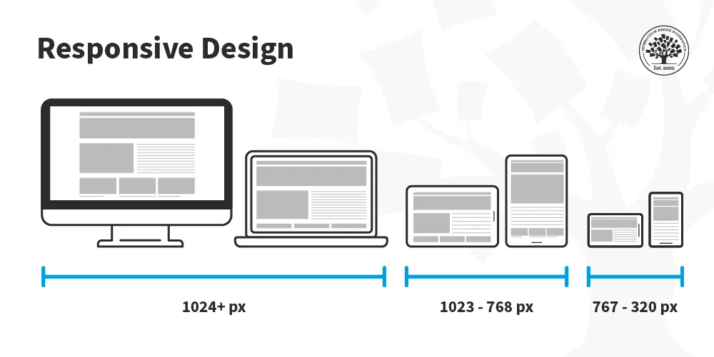

Slide 18
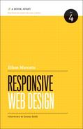
History of the Responsive Web Design
The term Responsive Web Design was first coined by Ethan Marcotte in his article A List Apart in May 2010
http://alistapart.com/article/responsive-web-design
He defined the technique of RWD by using fluid grids, flexible images, and media queries to deliver different visual experiences for different screen sizes.
Ethan expanded his RWD theory and
published his book titled
Responsive Web Design.

Slide 19
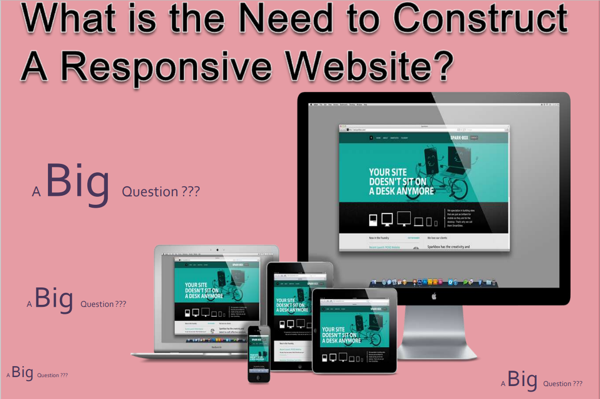

Slide 20
Why Should We Build a Responsive Web?
Each year new devices are pouring into the market, responsive web design let us build one site, and modify it to adapt the new device’s screen size
Build once for all devices
Easy to manage content editing through a single CMS (Content Management System)
If we have a working website:
Not need to rebuild new websites to adapt the new devices
We can convert the existing working website to a responsive Web site to adapt all kind of devices

Slide 21
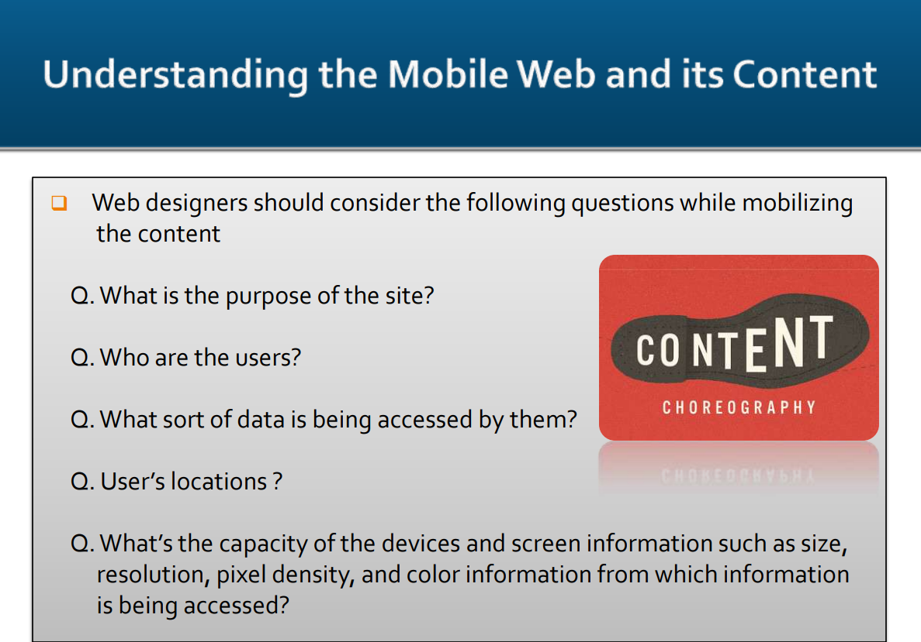

Slide 22
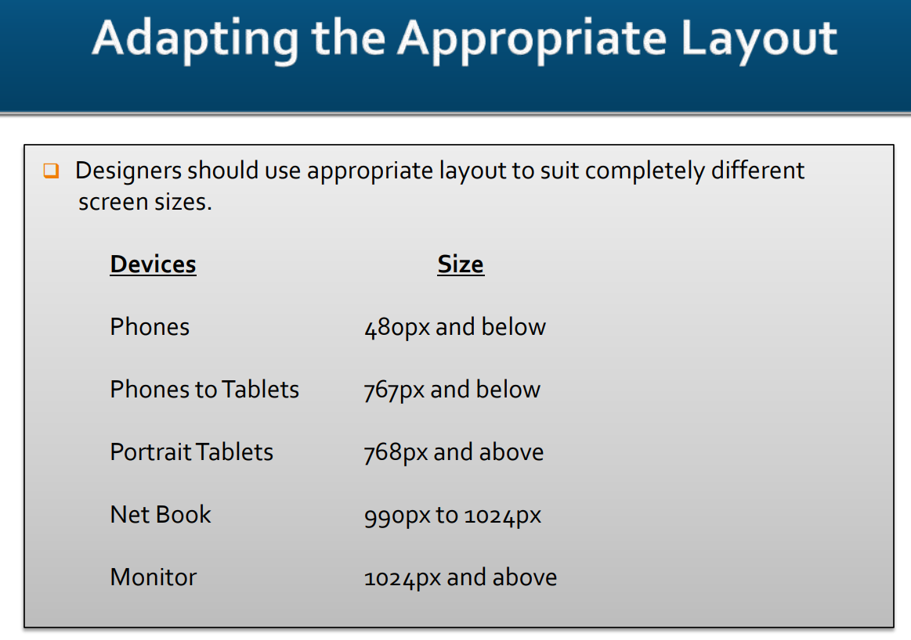

Slide 23
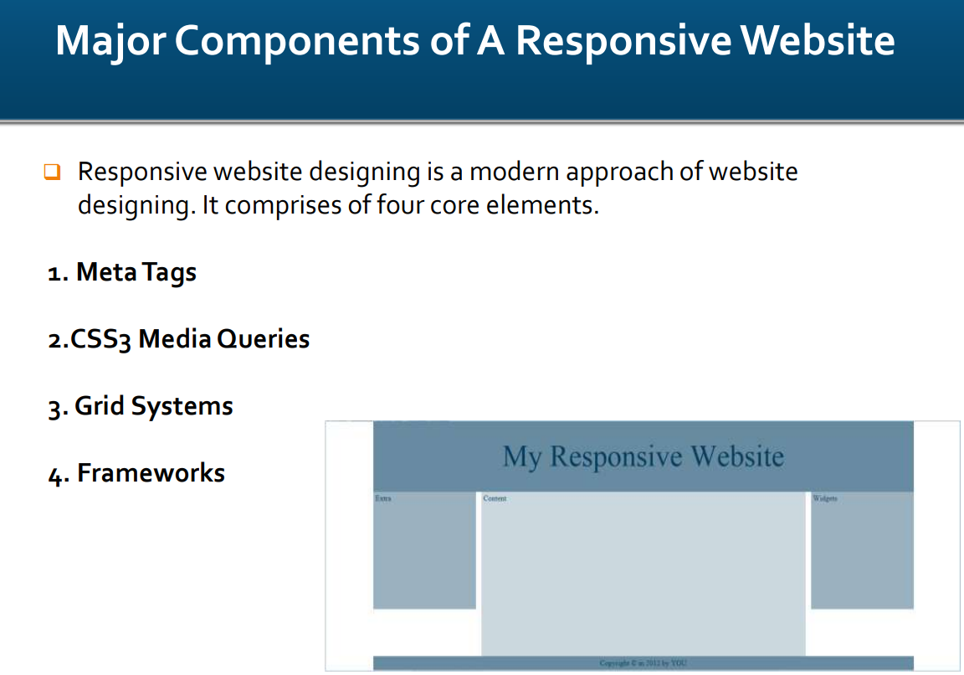

Slide 24
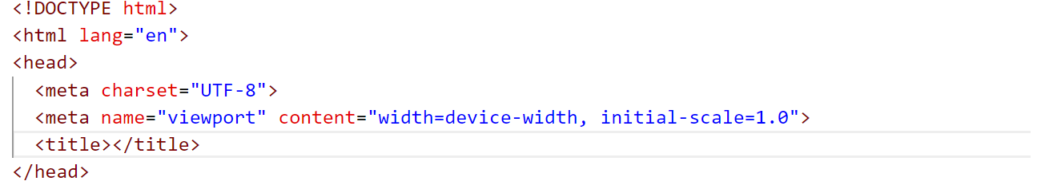
Meta Tag
The HTML <meta> tag provides metadata or information about the HTML document.
The metadata does not display on the webpage, but it is used by search engines, browsers and other web services which scan the site or webpage to know about the webpage..

Slide 25

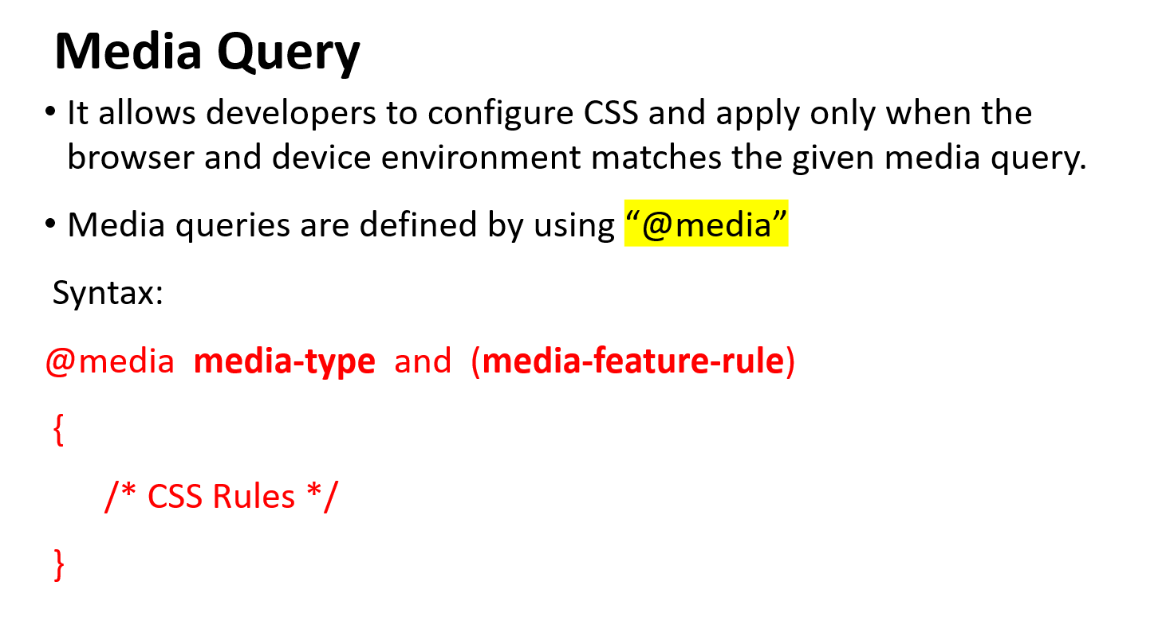

Slide 26
<style>
.box{
background-color: cyan;
font-size: 60px;
text-align: center;
color: black;
display: none;
}
@media only screen and (max-width:500px){
#item-3{
display: block;
background-color: red;
}
}
@media only screen and (min-width:500px) and (max-width:1000px){
#item-2{
display: block;
background-color: greenyellow;
color: white;
}
}
@media only screen and (min-width:600px){
#item-1{
display: block;
background-color: plum;
color: white;
}
}
</style>

Slide 27

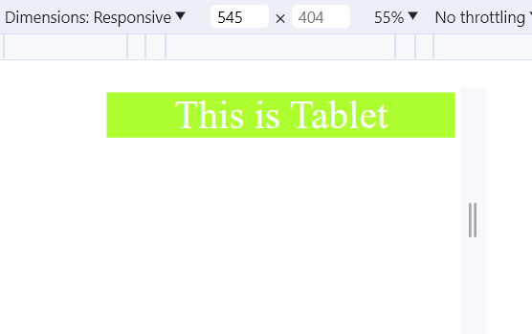
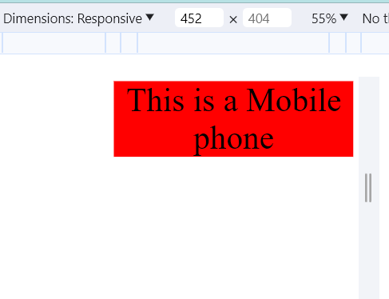
<body>
<div class="box" id="item-1">This is Laptop Screen</div>
<div class="box" id="item-2">This is Tablet</div>
<div class="box" id="item-3">This is a Mobile phone</div>
</body>
Above 600px

Slide 28
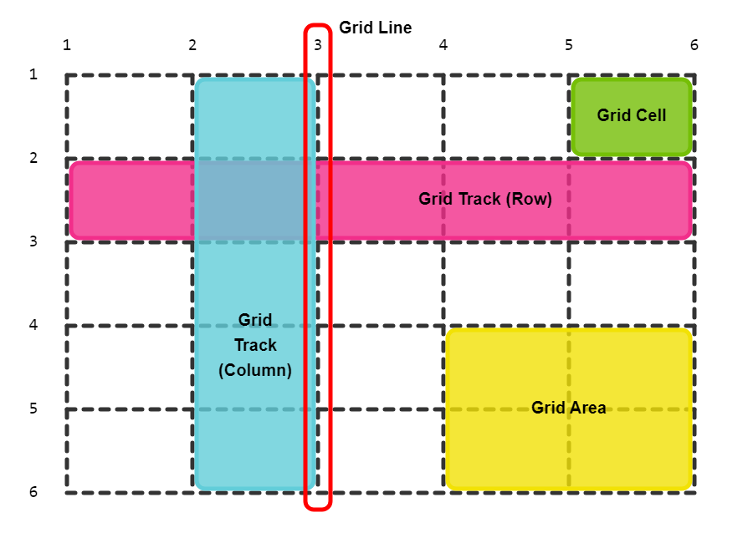
Grid System

Slide 29
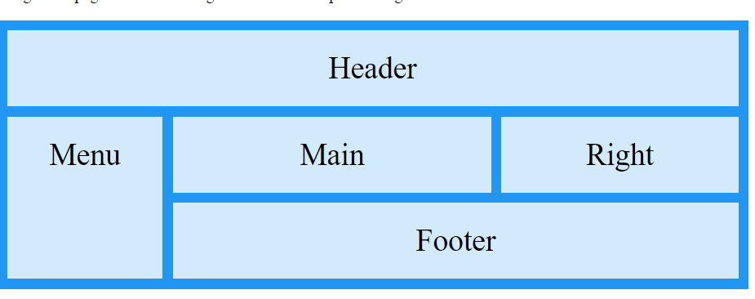

Slide 30
<body>
<h1>Grid Layout</h1>
<p>The CSS Grid Layout Module offers a grid-based layout system, with rows and columns, making it easier to design web pages without having to use floats and positioning:</p>
<div class="grid-container">
<div class="item1">Header</div>
<div class="item2">Menu</div>
<div class="item3">Main</div>
<div class="item4">Right</div>
<div class="item5">Footer</div>
</div>
</body>

Slide 31
<style>
.item1 { grid-area: header; }
.item2 { grid-area: menu; }
.item3 { grid-area: main; }
.item4 { grid-area: right; }
.item5 { grid-area: footer; }
.grid-container {
display: grid;
grid-template-areas:
'header header header header header header'
'menu main main main right right'
'menu footer footer footer footer footer';
gap: 10px;
background-color: #2196F3;
padding: 10px;
}
.grid-container > div {
background-color: rgba(255, 255, 255, 0.8);
text-align: center;
padding: 20px 0;
font-size: 30px;
}
</style>

Slide 32
Framework for RWD
The framework does a spectacular job of creating responsive website design easily and quickly.
RWD Framework
Bootstrap
Semantic UI
Base
Skeleton

Slide 33
How to check if a website is responsive
Open Google Chrome
Go to your website
Press Ctrl + Shift + I to open Chrome DevTools
Press Ctrl + Shift + M to toggle the device toolbar
View your page from a mobile, tablet, or desktop perspective

Slide 34
Benefits of Responsive Web Design.
Better SEO
One of the biggest advantages of having a responsive web design is improved search engine rankings. Google takes into consideration all websites responsiveness as one of the determiners of their rank in the search engine results. This only means that when your website is not responsive, it will automatically be placed lower in the search engine results.
2. Improved User Experience
A responsive website design makes your visitors have a positive experience regardless of which device they used. When your site visitors find that your website scales and responds to changes in scales effectively and they can access all the menus and buttons, they will probably spend much time on it.

Slide 35
3. Increase in Traffic
Traffic Statistics show that nearly 79 percent of all global web traffic comes from mobile devices. Actually, this accounts for more than half of all global Internet traffic
4. Easier and Simpler Website Analytics
To make inform decisions on how to improve your website, you need to know how your users interact with your website.

Slide 36
5. Faster Web Development
Initially, it was a common practice for website owners making a separate mobile version of their website whenever a smaller screen size was detected.
6. Easier Maintenance
Having a separate desktop and mobile website requires additional testing and support. When you have two different versions of your website, your development team will definitely have to divide time and resources to effectively manage them.

Slide 37
Disadvantages of RWD
Slow page loading: Though, responsive websites are easy to maintain, but it sometimes takes a long time to load the page. It includes some high-resolution images and videos that sometimes require a lot of time to load.
Complexity: Implementing a responsive design can be more complex and time-consuming than creating a separate mobile version of a website. The complexity increases as the size and features of the website grow.
Ensuring consistent performance across different browsers can be challenging. Some older browsers may not fully support responsive design techniques, leading to inconsistencies in layout and functionality

Slide 38

Try this….!
Design a UI for a smartwatch consider the screen width of 240px or 319px
Use linear gradient for background color for visually appealing design

Slide 39
